Slide 1


UNIT 1
Noida Institute of Engineering and Technology, Greater No​ida
Society State and Polity in India
Unit: 1
Essence of Indian Traditional Knowledge
AMICANC0502
Ms. Neha Singh
(Assistant professor)
MCAINT VI semester

Slide 2
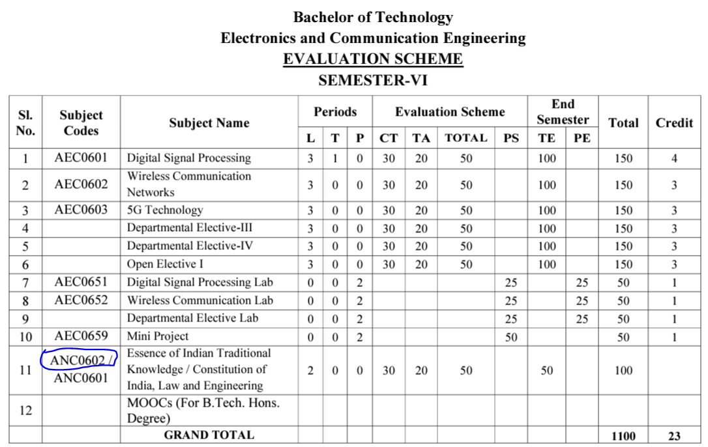
Evaluation Scheme (EC-6th Semester)

Slide 3
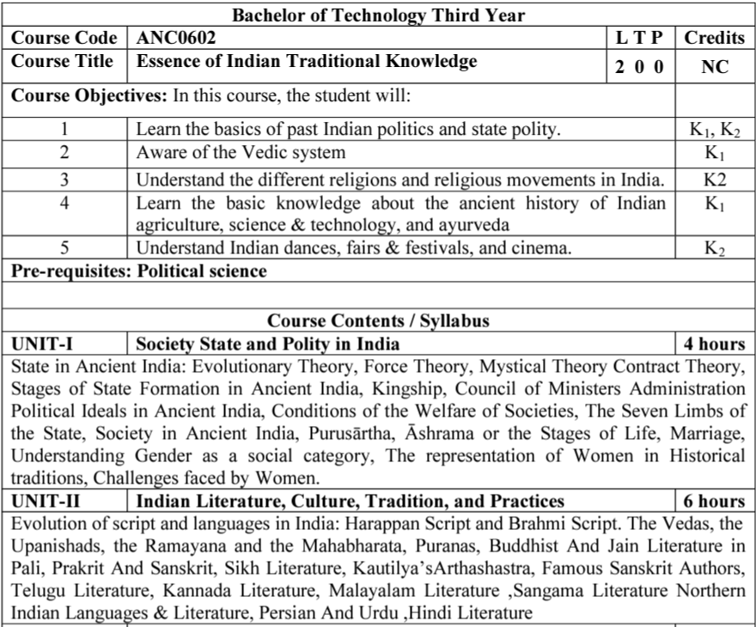
Syllabus

Slide 4
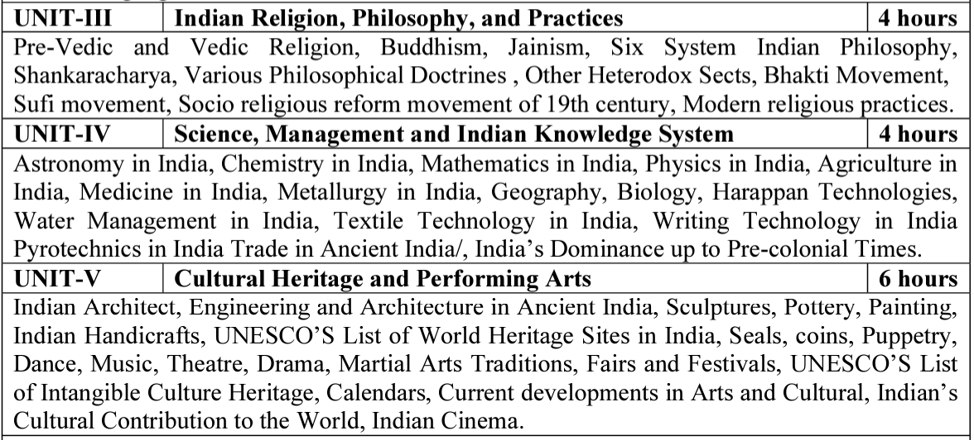
Syllabus(Continue….)

Slide 5
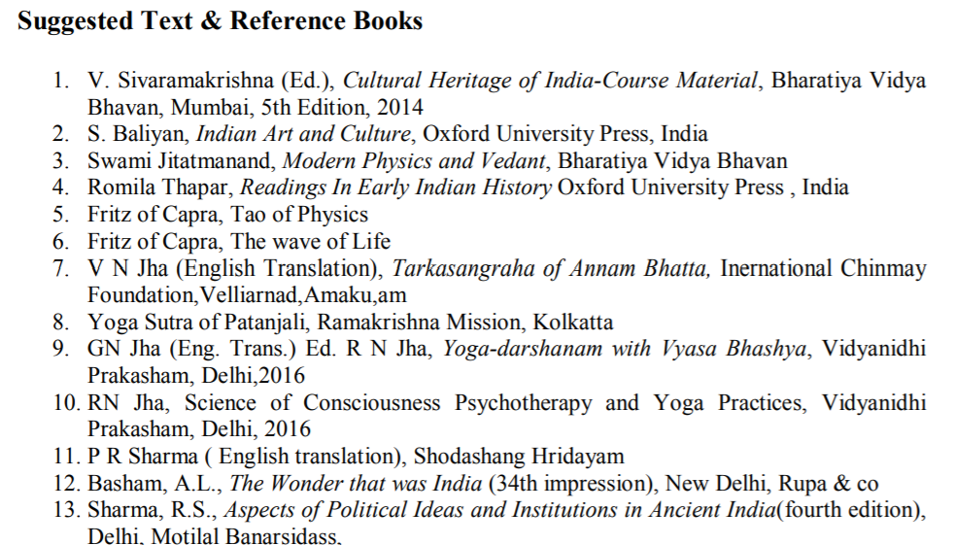
Text Books

Slide 6
Applications of Essence of Indian Traditional Knowledge
Can apply the old designing concept with blend of new trends in building construction
Learn the ancient living style
Indian Traditional knowledge modern scientific perspective
Apply the ancient advanced architectural wonders in current trends

Slide 7
Course Objective
Course Objectives:
The student will try to learn about:
To imparting the basic principles of thought process, reasoning and inference to identify the roots and details of some of the contemporary issues faced by our nation and try to locate possible solutions to these challenges by digging deep into our past.
To enable the students to understand the importance of our surroundings and encourage the students to contribute towards sustainable development.

Slide 8
Course Objective(Continue…)
To sensitize students towards issues related to ‘Indian’ culture, tradition and its composite character.
To make students aware of holistic life styles of Yogic-science and wisdom capsules in Sanskrit literature that are important in modern society with rapid technological advancements and societal disruptions.
To acquaint students with Indian Knowledge System, Indian perspective of modern scientific world-view and basic principles of Yoga and holistic health care system.

Slide 9
Course Outcome
At the end of this course students will able to:
CO1: Understand the basic principles of thought process & inference to identify the roots and details of some of the contemporary issues faced by our nation and try to locate possible solutions to these challenges by digging deep into our past.
CO2: Illustrate the importance of our surroundings and encourage the students to contribute towards sustainable development.
CO3: Interpret the issues related to ‘Indian’ culture, tradition, & its composite character.

Slide 10
Course Outcome (Continue…)
CO4: Aware of holistic life styles of Yogic-science and wisdom capsules in Sanskrit literature that are important in modern society with rapid technological advancements and societal disruptions.
CO5: Acquaint students with Indian Knowledge System, Indian perspective of modern scientific world-view and basic principles of Yoga and holistic health care system.

Slide 11
Program Outcomes
Program Outcomes are narrow statements that describe what the students are expected to know and would be able to do upon the graduation.
These relate to the skills, knowledge, and behavior that students acquire through the programmed.
Engineering knowledge
Problem analysis
Design/development of solutions
Conduct investigations of complex problems
Modern tool usage
The engineer and society
Environment and sustainability
Ethics
Individual and team work
Communication
Project management and finance
Life-long learning

Slide 12
Program Specific Outcomes
Program Specific Outcomes (PSOs) are what the students should be able to do at the time of graduation. The PSOs are program specific. PSOs are written by the department offering the program.
On successful completion of B. Tech. (EC) Program, the Electronics and Communication engineering graduates will be able to:
PSO1: To apply the knowledge of mathematics, science and electronics & communication engineering to work effectively in the industry based on same or related area.
PSO2: To use their skills to work in modern electronics & communication engineering tools, software and equipments to design solutions for complex problems in the related field that meet the specified needs of the society.
PSO3: To function effectively as an individual and as a member or leader of a team by qualifying through examinations like GATE (Graduate Aptitude Test in Engineering), IES (Indian Engineering Services), PSUs (Public Sector Undertakings), TOEFL (Test of English as a Foreign Language), GMAT (Graduate Management Admission Test) and GRE (Graduate Record Examinations in US) etc.

Slide 13
CO-PO and PSO Mapping
CO | PO1 | PO2 | PO3 | PO4 | PO5 | PO6 | PO7 | PO8 | PO9 | PO10 | PO11 | PO12 | PSO1 | PSO2 | PSO3
CO1 | - | - | - | - | - | - | - | 3 | - | - | - | 3 | - | - | -
CO2 | - | - | - | - | - | - | - | 3 | - | - | - | 3 | - | - | -
CO3 | - | - | - | - | - | - | - | 3 | - | - | - | 3 | - | - | -
CO4 | - | - | - | - | - | - | - | 3 | - | - | - | 3 | - | - | -
CO5 | - | - | - | - | - | - | - | 3 | - | - | - | 3 | - | - | -
Avg | - | - | - | - | - | - | - | 3 | - | - | - | 3 | - | - | -
*3= High *2= Medium *1=Low

Slide 14
Program Educational Objectives
The Program Educational Objectives (PEOs) of an engineering degree program are the statements that describe the expected achievements of graduates in their career, and what the graduates are expected to perform and achieve during the first few years after graduation.
PEO1: To have an excellent scientific and engineering breadth so as to comprehend, analyze, design and solve real-life problems using state-of-the-art technology.
PEO2: To lead a successful career in industries or to pursue higher studies or to understand entrepreneurial endeavours.
PEO3: To effectively bridge the gap between industry and academics through effective communication skill, professional attitude and a desire to learn.

Slide 15
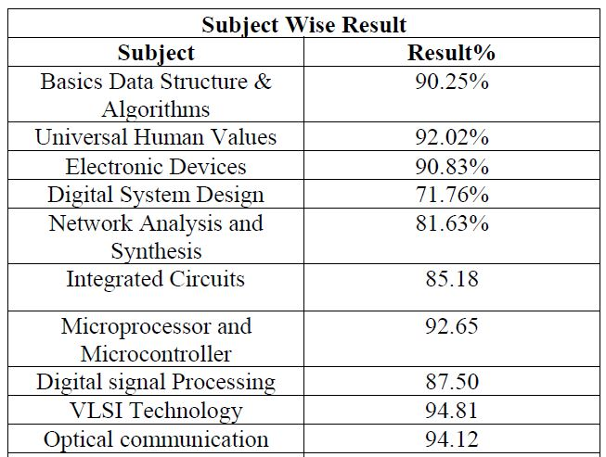
Result Analysis
Faculty Name | Subject Code | Section A | Section B
Mr. Anshu Kumar | ANC 0602 | 100 % | 100 %

Slide 16
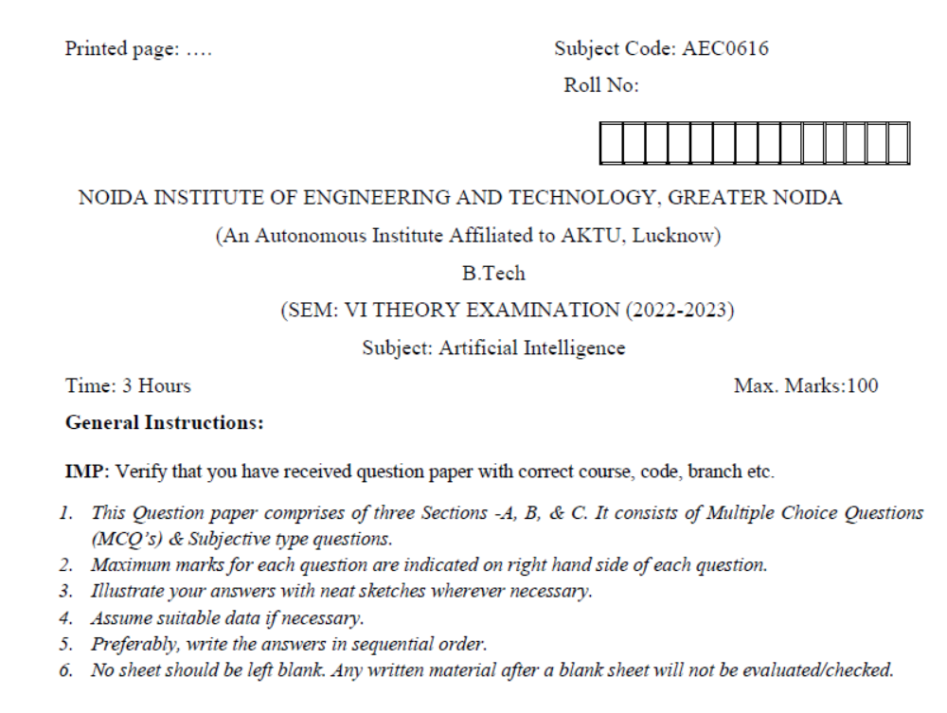
Question Paper Template

Slide 17
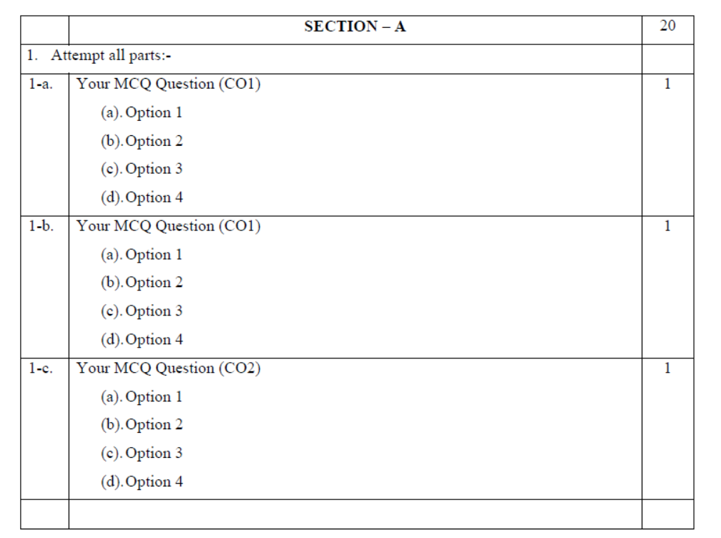
Question Paper Template (Cont……)

Slide 18
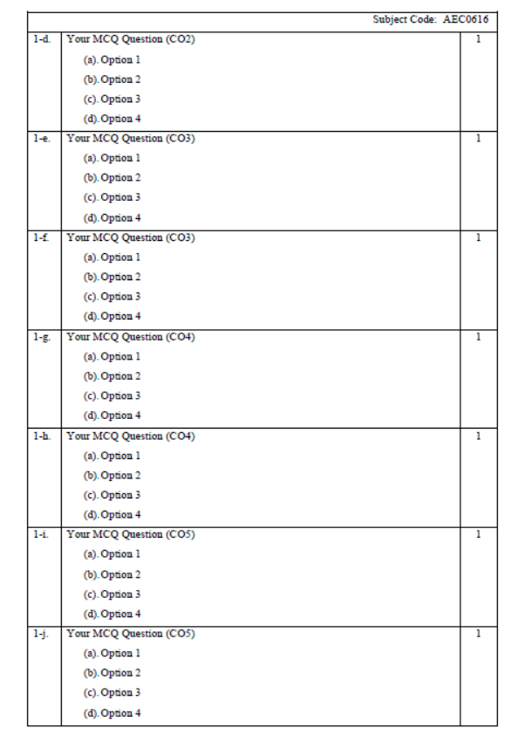
Question Paper Template (Cont……)

Slide 19
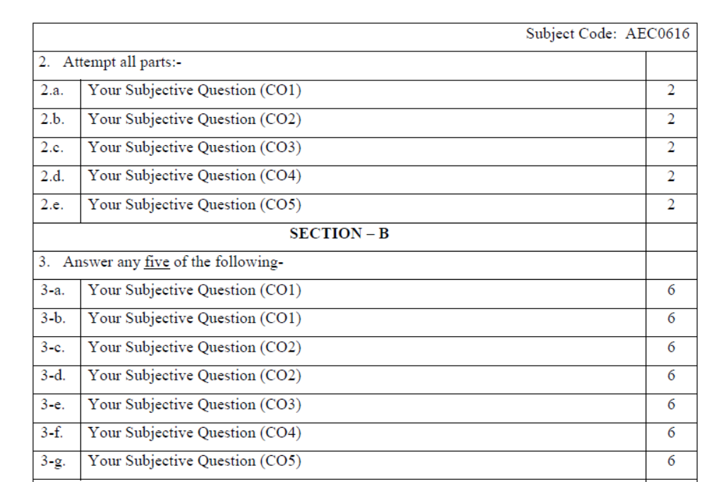
Question Paper Template (Cont……)

Slide 20

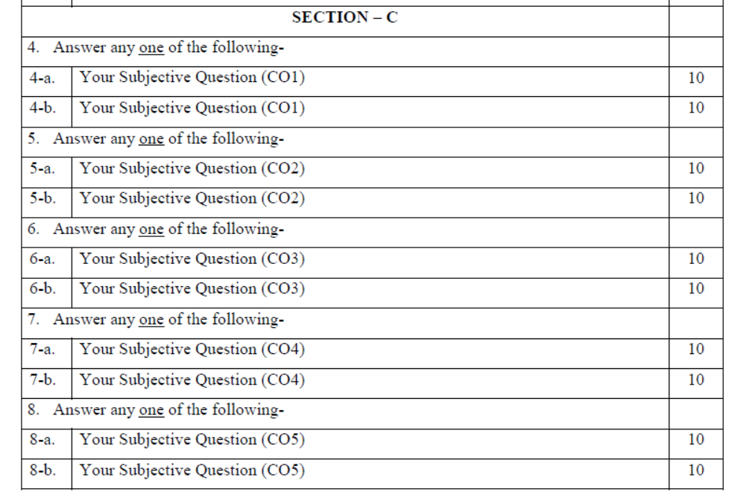
Question Paper Template (Cont……)

Slide 21
Prerequisite and Recap
Basic knowledge of Indian traditions, culture & society.

Slide 22
Brief Introduction about the subject with Video
The course aims at imparting basic principles of thought process, reasoning and inference & to identify the roots and details of some of the contemporary issues faced by our nation and try to locate possible solutions to these challenges by digging deep into our past. To enable the students to understand the importance of our surroundings and encourage the students to contribute towards sustainable development. To sensitize students towards issues related to ‘Indian’ culture, tradition and its composite character.
https://www.youtube.com/watch?v=jgQlf3DM_GU&t=625s

Slide 23
Unit 1 content
State in Ancient India:-
Stages of State Formation in Ancient India,
Kingship ,
Council of Ministers Administration
Political Ideals in Ancient India Conditions’ of the Welfare of Societies.
The Seven Limbs of the State & Society in Ancient India,
Purusārtha, Varnāshrama System, Āshrama & Marriage
Understanding Gender as a social category,
The representation of Women in Historical traditions,
Challenges faced by Women & Four-class Classification

Slide 24
Unit 1 Objective
To imparting the basic principles of thought process, reasoning and inference to identify the roots and details of some of the contemporary issues faced by our nation and try to locate possible solutions to these challenges by digging deep into our past.

Slide 25
Topic Objective
To study the different theories of the formation of society
To study the different theories of the formation of state
To study the different stages of state formation in Ancient India
To understand the theory of Kingship

Slide 26
Topic Mapping
S.No. | Topic | Course Outcome
1 | Different theories of society formation in Ancient India | CO1
2 | Stages of State Formation in Ancient India | CO1
3 | Kingship , Council of Ministers & Administration | CO1

Slide 27
Culture (CO1)
Meaning of culture: Culture is a way of life. The food you eat, the clothes you wear, the language you speak in and the God you worship all are aspects of culture.
Culture is the belief of a community that is transmitted from one generation to another through what is shown(plastic arts, symbols),what is told (stories, philosophy, literature) and what is done (performing arts, customs rituals).
Culture is the expression of our nature in our modes of living and thinking. It may be seen in our literature, in religious practices, in recreation and enjoyment.

Slide 28
Culture
Culture has two distinctive components, namely, material and non-material. Material culture consists of objects that are related to the material aspect of our life such as our dress, food, and household goods. Non-material culture refers to ideas, ideals, thoughts and belief.
ART: Art is the expression of culture. Art can be divided into two parts: 1. The Tangible (Literature, fine arts, sculptures, fashion, architecture, coins, pots, carving, etc.)
2. The Intangible (performing arts, music, dance and theater).
Art reveals what a culture values and admires, and what it is capable of and has a capacity for, and what it promotes and what it does not.

Slide 29
Art and Culture
What is the difference between Culture and Art?
Answer: Art is a subset of culture, a part of it. Therefore ,there must be some elements of ‘culture’ that are not considered as ‘art’. Here are few of them:
1. Language
2. Food habits
3. Knowledge system
4. Religious belief
5. Economic and political pattern

Slide 30
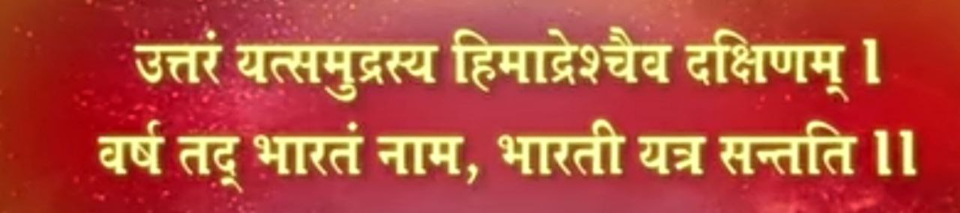
Bharata
Source : Vishnu Puran 2.3.1
Meaning: The country that lies north of the ocean and south of the snowy mountains(Himalaya) is called Bharatam there dwellers are called as Bharata or Bhartiya.

Slide 31
State defined
• A State is a set of institutions that possess the authority to make the rules that govern the people in one or more societies, having internal and external sovereignty over a definite territory.

Slide 32
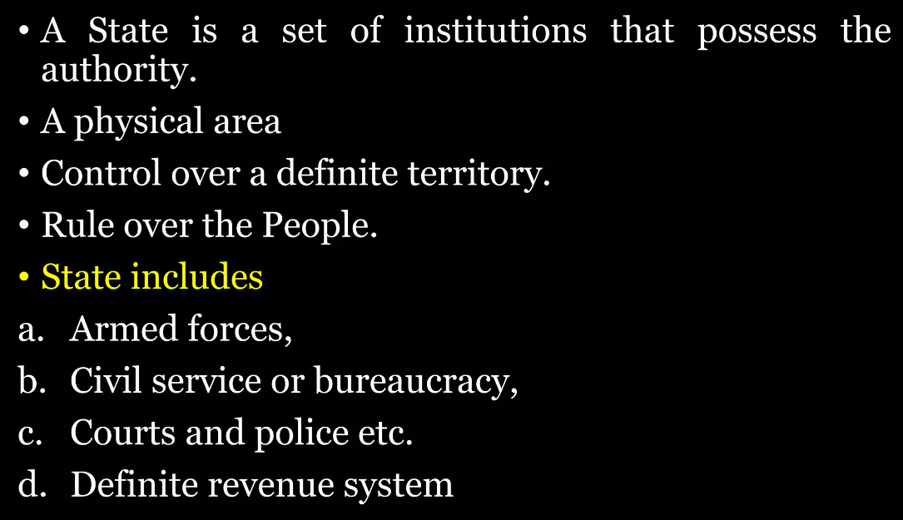
State in Ancient India (CO1)

Slide 33
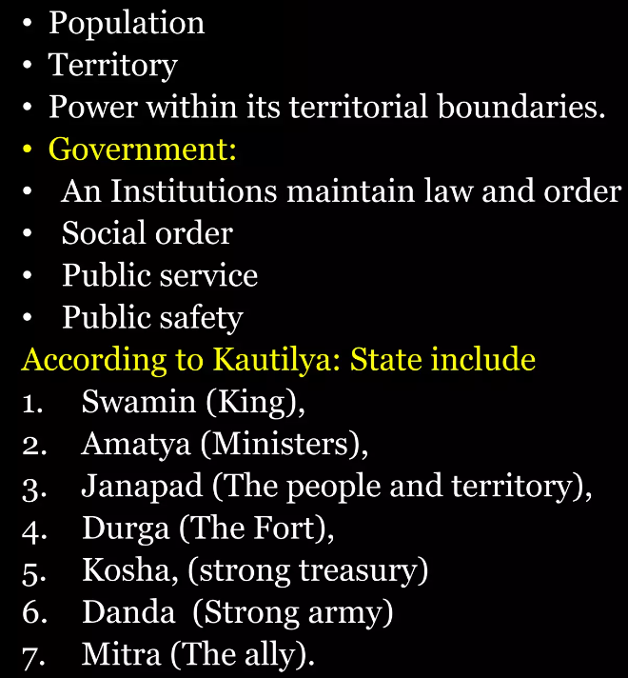
Features of State

Slide 34
State in Ancient India (CO1)
State has been the key concept in political science since the period of grand thinkers like Plato and Aristotle.
To look into the origin and evolution of the state has been one of the greatest issues in Political Science.
In ancient India also thinkers like Bhisma, Narada, Brihaspati, Kautilya, Kamandaka have looked at the problem.

Slide 35
State in Ancient India
On the basis of the writings of these thinkers we can detect four important theories regarding the origin of the state in ancient India, namely—
a) Evolutionary Theory
b) Force Theory
c) Mystical Theory
d) Contract Theory

Slide 36
Theory of Evolutionary Origin
This is the oldest theory of the origin of the state in India and has been mentioned in the Atharva Veda. According to this theory the state is the result of evolutionary progress and it didn’t originate at a fixed time.
The tenth hymn of the eighth chapter of the Atharva Veda gives a picture of the evolutionary origin of the state.
On the basis of Atharva Veda several stages of the evolution of the state can be traced.

Slide 37
Theory of Evolutionary Origin
The hymns of the Atharva Veda state that the earliest phase of human life was the stage of vairājya or stateless state. It was a state of complete anarchy.
But subsequently, with the emergence of agriculture, stable life became possible.
To fulfil the needs of agricultural society the family emerged and the head of the family became the first wielder of authority. Further, the need of co-operation in the different realms of society led to the emergence of sabhā and samiti.

Slide 38
Theory of Evolutionary Origin
Sabhā was the organisation of elderly people and samiti was the general assembly of common people.
With the emergence of sabhā and samiti organised political life began which finally culminated in the emergence of the state.
A.S. Altekar, N.N. Law and H.C. Raychaudhuri somehow favour the theory of evolutionary origin.
Altekar opines that as with other Indo-Aryan communities, the state also evolved in India in pre-historic times out of the institution of the joint family.

Slide 39
Force Theory
Though ancient Indian political thinkers did not propound force theory in a systematic way, force was considered to be an important factor in the evolution of the state in India.
Earliest Aryan clans fought among themselves for pet animals (specially for the cow), pastureland, settlements and sources of drinking water.
Only a strong and able warrior could lead the clan in such wars. So he was given special status and the members of clan started obeying him.

Slide 40
Theory of Mystical Origin
This was the most popular theory of origin of the state in ancient India.
Kingship was given divine sanction and the king was considered not to be the representative of God but himself a God who contained the powers of important Gods like Indra, Varuna and Agni.
According to A.L. Basham the doctrine of royal divinity was explicitly proclaimed.
It appears first in the epics and the law books of Manu.

Slide 41
Theory of Mystical Origin
John Spellman also favours the view that the theory of divine origin was the dominant and popularly accepted theory regarding the origin of the state in ancient India.
According to Spellman “The king was appointed by the God and ruled through divine grace.”
The king would be punished only by divine powers.
The king was supposed to follow the divine laws and not man-made laws.
Spellman concludes that in ancient India, the basic notion of the origin of the state was based on divine creation

Slide 42
Theory of Mystical Origin
There were five types of yajnas in Vedic times: hom, isti, pashu, soma and satrayaga.
There were also special yajnas for securing kingdoms such as rajasuya, vajapeya, Ashvamedha and naramedha.
Rajasuya and Ashvamedha yajnas were known even during the days of the Ramayana and the Mahabharata.

Slide 43
Contract Theory
Contract theory is the most extensively discussed theory of the origin of the state in ancient India.
The reference to contract theory can be seen in the Buddhist texts like Dīgha Nikāya and Mahāvastu and other texts like Shānti Parva and Arthashāstra of Kautilya.
According to Buddhist text Dīgha Nikāya there was a time when people were perfect, and lived in a state of happiness and tranquility.
This perfect state lasted for ages, but at last the pristine purity declined and there set in rottenness.

Slide 44
Contract Theory
But slowly slowly heavenly life degenerated into earthly life. Now shelter, food and drink were required.
People gradually entered into a series of agreements among themselves and set up the institutions of the family and private property.
But this gave rise to a new set of problems, for there appeared theft and other forms of unsocial conduct.
Therefore, people assembled and agreed to choose as chief a person who was the best favoured, the most attractive and the most capable. In return they agreed to contribute to him a portion of their paddy.

Slide 45
Contract Theory
According to the Arthashāstra of Kautilya, It states that overtaken by a state of anarchy the people elected Manu Vaivasvata as their king and undertook to pay 1/6th of their grain, and 1/10th of their articles of merchandise in addition to a portion of their gold.
In return for these taxes the king guaranteed social welfare to the people by undertaking to suppress acts of mischief, afflicting the guilty with taxes and coercion.
Even the inhabitants of the forest were required to give him 1/6th of the forest produce. This account of the origin of the state closes with
the moral that the king should not be disregarded.

Slide 46
Society
A society has its structural units such as family, institutions such as marriage, and customs and practices such as inheritance, rituals of marriage and mourning, and finally a framework of individual and social life as for example the āśrama vyavasthā laid down in the ancient society as an ideal organization of an individual’s life.
Indian society is among the oldest societies in continuous existence with broadly the same ancient social system codified in the long continuous, cumulative attested textual tradition of sociological texts known as Dharmasūtras, Dharmaśāstras and Nibandhas.

Slide 47
Stages of State Formation in Ancient India (CO1)
Six main stages in the history of ancient Indian polity can be identified.
1. First stage:- Tribal military democracy
2. Second stage:- Break-up of the tribal polity
3. Third stage:- Formation of the full-fledged state
4. Fourth Stage(Maurya phase):- Bureaucratic centralisation
5. Fifth Stage:- Decentralised administration
6. Sixth stage(Gupta Period):- Proto-feudal polity.

Slide 48
Stages of State Formation in Ancient India
First stage:- Tribal military democracy
The earliest stage was that of tribal military democracy in which tribal assemblies, which had some place for women were mainly pre-occupied with war.
The age of Rig Veda was primarily a period of assemblies.
Second stage:- Break-up of the tribal polity
The second stage saw the break-up of the tribal polity under the stress of constant conflicts between the rājanyakshatriya and the ordinary businessman called the vis.

Slide 49
Stages of State Formation in Ancient India
The chiefs were helped by the priesthood called the brahmins. This stage saw the beginning of taxes and classes or varnas which came to be firmly established in the third stage.
Third stage:- Formation of the full-fledged state
The third stage was marked by the formation of the full-fledged state.
There arose large territorial monarchies of Kosala and Magadha and tribal oligarchies in North-Western India and at the foot of the Himalayas. For the first time large standing armies and organised machinery were used for the of collection of land revenue.

Slide 50
Stages of State Formation in Ancient India
Fourth Stage(Maurya phase):- Bureaucratic centralisation
The fourth or the Maurya phase saw bureaucratic centralisation based on the expanding economic activities of the state.
The state with the help of its bureaucracy controlled various aspects of the life of its subjects.
Fifth Stage:- Decentralised administration
The fifth stage was marked by the process of decentralised administration in which towns, feudatories and military elements came to the forefront in both the Deccan and North India. This was partly neutralised by the emphasis on the divinity of the king.

Slide 51
Stages of State Formation in Ancient India
Sixth stage(Gupta Period):- Proto-feudal polity.
The last stage, identical with the Gupta period, may be called the period of proto-feudal polity.
Land grants now played an important part in the formation of the political structure.
Those made by the Gupta feudatories conferred fiscal and administrative privileges on priestly beneficiaries.

Slide 52
Definition
Citizen : A member of a political community, having both rights and duties associated with that membership.
Legitimacy : The belief that a particular political order is just and valid.
State Society : A society which possesses a formal apparatus of government.
Stateless Society : A society which lacks formal institutions of government.
Social Mobility : Movement from one status or occupation to another.
Sovereignty : The undisputed political rule of a state over a given territorial area.

Slide 53
Kingship (CO3)
The king was the most important figure in the body politic. In the Saptānga theory of the state, developed by Kautilya the king has been described as the head or the most important organ of the state.
The earliest legend on the origin of kingship occurs in the Aitareya Brdhmana one of the later Vedic texts, perhaps of the 8th or 7th century B.C.
The king was evidently the fellow of the gods, if not a god himself.
The legend suggests that in the earliest times kingship in India was thought to be based upon human need and military necessity, and that the king's first duty was to lead his subjects in war.

Slide 54
Kingship
But the later stage the king performed multi-dimensional functions.
The king’s functions involved the protection not only of his kingdom against external aggression, but also of life, property and traditional custom against internal foes.
He protected the purity of class and caste by ensuring that those who challenged the system were excommunicated(punished).
He protected the family system by punishing adultery and ensuring the fair inheritance of family property.
He protected widows and orphans by making them his wards.

Slide 55
Kingship
He protected the rich against the poor by suppressing robbery, and he protected the poor against the rich by punishing extortion and oppression.
The Arthashāstra suggests a time-table for the king’s day, which allows him only four and a half hours sleep and three hours for eating and recreation and the rest of the day being spent in state affairs of one kind or another.
No doubt such a programme was rarely kept in practice, but it at least shows the ideal at which the king was expected to aim.

Slide 56
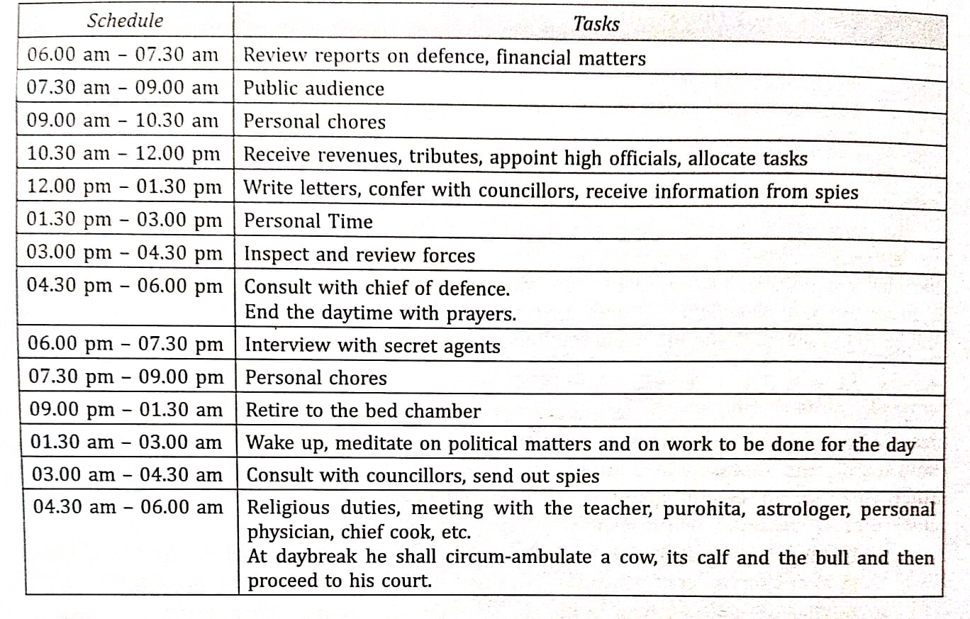
Kingship
The typical 24-hour Schedule for the King

Slide 57
Kingship
According to Altekar the position, powers and privileges of the king have varied from age to age.
When in the prehistoric period, the king was only the senior-most member in the council of peers, when he often owed his position to an election, either real or formal, when there was a popular council (samiti) to actively supervise his administration, his position was often insecure and powers were limited.
After 500 B.C.E. the office of king was elevated to new heights. During this period the king became the effective head of the executive administration and there was no popular assembly like samiti to check him.

Slide 58
Recap
Different theories of society formation in Ancient India
In this topic, we have learned the Stages of State Formation in Ancient
India, the different theories of the formation of state.
We also learned, the Kingship.

Slide 59
Daily Quiz
Dīgha Nikāya is the text of ______.
A. Jainism
B. Buddhist
C. Hindus
D. Muslim
How many stages of state formation in Ancient India were existed?
A. Four
B. Five
C. Six
D. Seven
Which period called the proto-feudal polity period?
A. Maurya
B. Gupta
C. Vedic
D. Harappan

Slide 60
Daily Quiz
Which philosopher depicted the individual as noble savage in the state of nature?
A. Hobbes
B. Rousseau
C. Locke
D. V.A. Smith
Which philosopher depicted the individual as noble savage in the state of nature?
A. Hobbes
B. Rousseau
C. Locke
D. V.A. Smith
There are six stages of state formation existed.
A. True
B. False

Slide 61
Daily Quiz
“The king was appointed by the God and ruled through divine grace”-this is the statement of which historian?
A. Hobbes
B. John Spellmen
C. Locke
D. V.A. Smith
“The king was appointed by the God and ruled through divine grace”-this statement related to which theory of state formation?
A. Evolutionary theory
B. Force Theory
C. Mystical Theory
D. Contract Theory
King punished by divine power (in context of Mystical theory)
A. True
B. False

Slide 62
Weekly Assignment
Describe the different theories of the origin of state in Ancient India.
What are the stages of state formation in ancient India? Also explain Kingship.

Slide 63
Prerequisite
Basic knowledge of Indian society
Mauryan Empire history
Gupta period ruler’s history

Slide 64
Topic Objective
To study the different theories of the formation of society
To study the formation of council of state and its administration
To study the political ideals & condition of welfare state in Ancient
India

Slide 65
Topic Mapping
S.No. | Topic | Course Outcome
4 | Council of Ministers & Administration | CO1
2 | Political Ideals in Ancient India | CO1
3 | Conditions’ of the Welfare of Societies, | CO1

Slide 66
Council of Ministers (CO1)
Ministers or council of advisors have been regarded by ancient Indian political thinkers as a very vital organ of the body politic.
The Mahābhārata observes at one place that the king is as vitally dependent upon ministers as animals are upon clouds, brahmins on the Vedas and women upon their husbands.
The size of this mantriparishad or council of ministers varied, and the authorities suggested figures ranging from seven to thirty-seven. It seems that the body was divided into two parts mantrina and mantriparishad.

Slide 67
Council of Ministers
Mantriparishad was the large body resembling a modern council of ministers. It consisted of all the ministers.
Mantrina was a smaller body or a core organisation within the mantriparishad largely resembling the modern cabinet. It included the few most important ministers like the purohita (priest), senāpati (supreme commander of army) and yuvarāja (the crown prince).
R.C. Majumdar has compared the Mauryan council of ministers with the Privy Council of Britain and viewed it as a political body which formulated the policies of government.

Slide 68
Council of Ministers
Next to the king came the mantri pariṣad (council of ministers). The king was enjoined to discuss every matter with his Council of Ministers, which had two levels, inner and outer.
The inner cabinet had four members: the Chief Minister, the Chief Priest, the Military Commander and the Crown Prince. The membership of the outer cabinet was not fixed in number; invariably the heads of the prominent guilds were co-opted in this body.
Unlike the basic principle of Western monarchy, the ‘Divine Right of Kings’, the king was to regard himself as an agent of the people and had to abide by his dharma as laid out in the Śāstras.

Slide 69
Council of Ministers
The council's purpose was primarily to advise the king, and not to govern, but it was no mere rubber stamping body.
For all authorities stress that councilors should speak freely and openly and that the king should give full consideration to their advice.
In fact, the council often exerted great powers. It might transact business in the king's absence, and the Ashokan inscriptions show that it might take minor decisions without consulting him.
Ashokan edicts III and VI throw further light upon the working of the council of ministers.

Slide 70

Council of Ministers
The third edict shows that the council's orders were to be duly recorded and expounded to the public by local officers.
The sixth edict discloses that the oral orders of the emperor, as well as the decisions of the departmental heads taken in urgent cases were subject to review by the council of ministers.
On the basis of Ashokan edicts Altekar concludes that the council of ministers was not merely a recording body, for very often it used to suggest amendments to king's orders or even recommended their total reversal.

Slide 71
Administration (CO1)
Arthaśāstra is divided into sixteen books dealing with virtually every topic concerned with the running of a state: taxation, law, diplomacy, military strategy, economics, bureaucracy etc.
It advocates rational ethics in the conduct of the affairs of the state and emphasizes the codification and uniformity of the law throughout the state.
With the advent of the Mauryas on the political stage of India, bureaucracy developed as a well organized, hierarchical, cadre-based administrative system.

Slide 72
Administration (CO1)
The basis of good governance, according to Kauṭilya, is knowledge and Arthashastra classifies the knowledge needed to run a State into four classes: (Four branches of Knowledge):
Anvīkṣki (Science of Logic and Argumentation): is considered as the lamp that illuminates all sciences and is fundamental to understand the other branches of knowledge.
A proper study of Philosophy helps one to distinguish between dharma and adharma expounded in vedas.
It also teaches one to distinction between good and bad use of force.

Slide 73
Administration (CO1)
Trayi (The vedas): (the three Vedas, Sāma, Ṛg and Yajur). However Kautilya has also included the Atharvaveda and itihasa in his definition the vedas.
A study of the three Vedas is useful because it establishes the social order and the roles and responsibilities of the various sections of the society in practicing dharma.
These texts establish the four classes (varṇas) and the four orders (āśramas).
Vārta (Economics): Agriculture, cattle breeding, and trade constitute the economic activity.

Slide 74
Administration (CO1)
They are the main source of wealth for the king to augment his treasury.
Only with a healthy treasury the king can maintain a good army and provide security to the citizen and keep the enemies under control.
Dandaniti (Governance): Maintenance of the law and order using a regulatory and a control framework is important.
Proper functioning of the government and addressing the regulatory and control requirements will ensure that the state makes material progress, the citizens are happy and the weak in the society do not feel oppressed by the stronger forces.

Slide 75
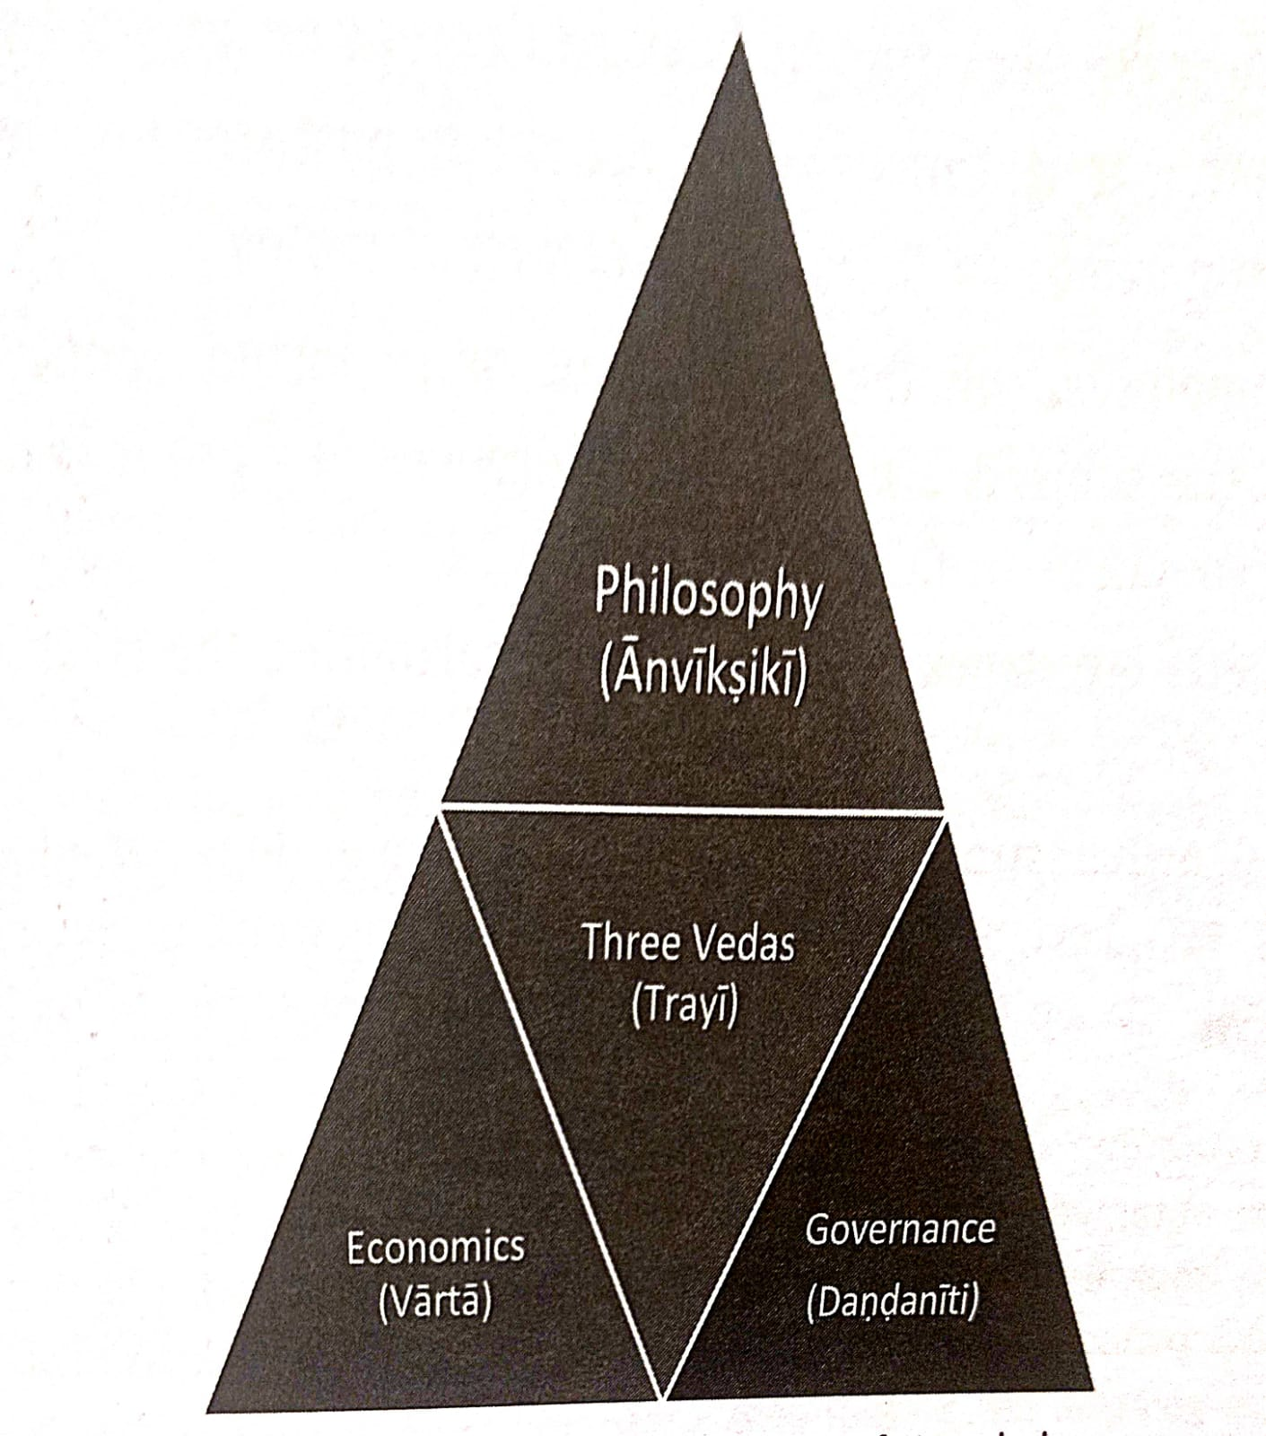
Administration
Fig: The Four Branches of Knowledge

Slide 76
Administrative set-up
The entire administrative setup and the hierarchy could be classified under six major heads:
King and his cabinet: Acarya, Purohit, Yuvaraja, Queen ,these constitute the personal circle of the king and play an advisory role to the king in formal as well as informal positions.
Palace administration: Administrative palace and the secretarial
Defence
Treasury
Revenue and Law & order
Civil administration

Slide 77
Political Ideals in Ancient India (CO1)
Political ideals like liberty, justice, fraternity and nationalism are a product of the modern age.
Showing the importance of freedom the Vedas state that independence is necessary for mankind and those who are not independent are worse than dead.
For disposal of justice the Mauryan state had a system of judiciary.
Dharmasthīya was the civil court and kantakashodhana was organised to deal with a large number of economic crimes.
The Rāmāyana extols this country as a karmabhūmi, the land of pious acts.

Slide 78
Political Ideals in Ancient India
This shows the belongingness of people to land and their fellow beings. The early seeds of nationalism can be traced in this instance.
Similarly, the ideal of ancient Indian thinkers was vasudhaivakutumbakam (treating the whole world like a family.) This was the concept of universal brotherhood or fraternity.

Slide 79
Conditions’ of the Welfare of Societies (CO1)
The term ‘welfare’ can be understood as a state or condition of well being, good fortune, happiness or prosperity of an individual in a community.
Welfare in the life of the state indicates a guarantee of collective social care of its citizens.
The Kautilyan concept of ‘Yogakshema’-welfare of citizens was based on the practical concerns of good governance.
Kautilya’s concept in its scope was a holistic one in which the social responsibility of welfare was not only for the individual or the society but for the whole of humanity, nature and cosmos.

Slide 80
Conditions’ of the Welfare of Societies (CO1)
Kautilya say that a king must take care of children, old, ill, suffering people , barren woman and woman with child, and those who don’t have anybody to look after. In other words, the king must ensure the yoga and ksema of the subjects.
Yoga refers to the successful accomplishment of an object, while ksema refers to the peaceful, undistributed enjoyment of that object.
Yoga-Ksema in a way encompasses the idea of welfare, well-being, including the idea of prosperity and happiness.
The state is expected to engage in various kinds of activities that bring welfare to the subjects.

Slide 81
Conditions’ of the Welfare of Societies
In the ancient scheme of thought human welfare was to be ensured through an organised form, be it the society or the state.
The Kautilyan state was to make optimum use of all possible resources for the benefits of the state and its citizens.
The ruler was both the master and the servant of his people.
He, as master, had to protect the people by virtue of law; as servant, he served the people by following his ‘svadharma’ or duties of protecting the life, property and territory of his people and kingdom.
Kautilya sought a centralised government by experts because the dispension of welfare was one of the chief duties of the administration.

Slide 82
Conditions’ of the Welfare of Societies
In the Kautilyan state duties had precedence over rights. Working towards the well being of the people was the concurrent duty of the individual, society and state.
Observance of ‘Svadharma’ one’s own duty was the pillar of socio-political life and everyone from king to the humblest person had to observe one’s ‘Svadharma’.
Kautilya also held that observance of proper balance between privileges and duties alone could lead to social harmony.
Rather than making incessant demand for more and more rights, people could enjoy them within a limit without forgetting their duties.

Slide 83
Recap
Different theories of society formation in Ancient India
In this topic, we have learned the formation of council of state and its
administration.
We have also learned, the political ideals & condition of welfare state in
Ancient India.

Slide 84
Daily Quiz
Which period called the proto-feudal polity period?
A. Maurya
B. Gupta
C. Vedic
D. Harappan
Which one is not the part of condition of welfare of state in Ancient India?
A. Judiciary
B. Nationalism
C. Secularism
D. Independence
Amātya was the minister in the Mauryan Darbar.
A. True
B. False

Slide 85
Daily Quiz
According to Arthashastra of Kautila, what is Dandanīti?
A. The code of conduct of Amatya
B. The administration of force
C. The conduct of kings
D. The essence of Politics
"Where the land is kingless die cloud, lightning wreathed and loud voiced, gives no rain to the earth”, is described about _____.
A. Administration of any state
B. Mantrina
C. Political ideals in ancient India
D. Kingship
Priest was not the member of mantrina during Mauryan period.
A. True
B. False

Slide 86
Daily Quiz
What is ‘mahāmātras’ mentioned in the Kautila’s Arthashāstra?
A. Tirthas
B. Amātya
C. Adhyaksas
D. Yogakshema
What is Dharmasthīya in the Mauryan state?
A. Court deal with a large number of economic crimes
B. Criminal Court
C. Civil court
D. Welfare organisation of Widow and orphan child
Arthashastra was written by Kautilya.
A. True
B. False

Slide 87
Weekly Assignment
What were the Conditions of the Welfare of Societies in ancient India?
What were Political Ideals in Ancient India?
Explain the four branches of Knowledge prescribed in Arthasastra.

Slide 88
Prerequisite
Different theories of society formation in Ancient India
Basic Knowledge of Indian Society.
Knowledge of Vedas
Knowledge of Manusmriti

Slide 89
Topic Objective
To study the different theories of the formation of society
To understand the seven limbs of the state and the society in ancient India.
To study the Purusartha and the Varnashrama system
To study the Ashrama or the stage of life system and Marriage.

Slide 90
Topic Mapping
S.No. | Topic | Course Outcome
1 | The Seven Limbs of the State & Society in Ancient India | CO1
2 | Purusārtha & Varnāshrama System | CO1
3 | Āshrama or the Stages of Life & Marriage | CO1

Slide 91
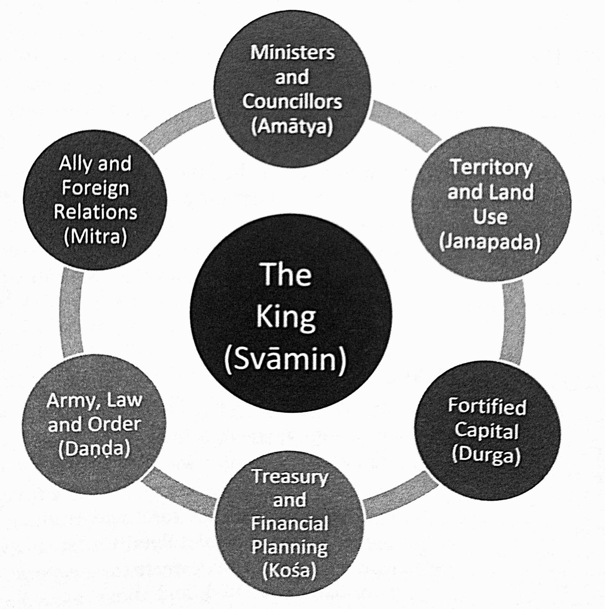
The Seven Limbs of the State(CO1)
Kautilya enumerated seven prakritis or essential organs of the state. They are as follow:
(i) Swami (The Ruler or The King)
(ii) Amatya (The Minister)
(iii) Janapada (The Population)
(iv) Durga (The Fortified Capital)
(v) Kosha (The Treasury)
(vi) Danda (The Army)
(vii) Mitra (Ally and Friend)

Slide 92
The Seven Limbs of the State
Swami(The Ruler) :- It is the first and the most important element. Swami means the monarch.
He should be a native of the soil and born in a noble family. He should be brave and well learned. He makes all the important appointments and supervises the government. He has to be virtuous and should treat his subjects like his own children.
Kautilya has given extensive powers to the monarch but those powers are meant for the welfare of them subjects. In the welfare and happiness of his subjects, lies his own happiness.

Slide 93
The Seven Limbs of the State
Amatya (The Minister) :- It refers to the council of ministers as well as the supporting officials and subordinate staffs. They are meant for assisting the monarch in day to day affairs of the state.
Amatya gives suggestions to king, collects taxes, develops new villages and cities, ensures defense of the state and all other tasks as assigned by the king.
Janpada (The Population):- It refers to territory and people of the state. The territory of the state should be fertile and should have abundance of forest, rivers, mountains, minerals, wild life etc. It should have good climate.

Slide 94
The Seven Limbs of the State
People should be loyal to their king, hard working, disciplined, religious, ready to fight for their motherland, should pay taxes regularly and happily.
Durga (The Fortified Capital) :-It refers to forts. The state should have sufficient number of forts across its territory at strategic locations for ensuring defense against foreign invasions.
Forts should be built near hills/mountains, deserts, dense forests and big water bodies. They garrison soldiers, store food grains for emergency and also serve as a hideout for the king when his life in danger.

Slide 95
The Seven Limbs of the State
Kosha(The Treasury) :- This means treasury of the state. Finance is life blood of any state without which it is almost impossible to run it. Money is needed for paying salaries, building new infrastructure, etc.
The treasury should be full of money and valuable metals and gems.
It can be increased through taxation and plundering enemy states in war.
Danda(The Army) :- It refers to military. The state should have a regular, large, disciplined and well trained military. It is crucial for the security of the state.
The soldiers should be recruited from those families which are traditionally associated with military.

Slide 96
The Seven Limbs of the State
The soldiers should paid well and their families should be taken care of in most suitable way. Proper training and equipment should be made available. Well fed and well trained soldiers can win any battle.
The king should take care of the soldiers and the soldiers will be ready to sacrifice even their life for him.
Mitra (Ally and Friend) :- It refers to friends of the king. The monarch should maintain friendly relationship with traditional friends of his forefathers. He should also make new friendships.
He should send gifts and other pleasantries for his friends. They should be helped in times of emergency.

Slide 97
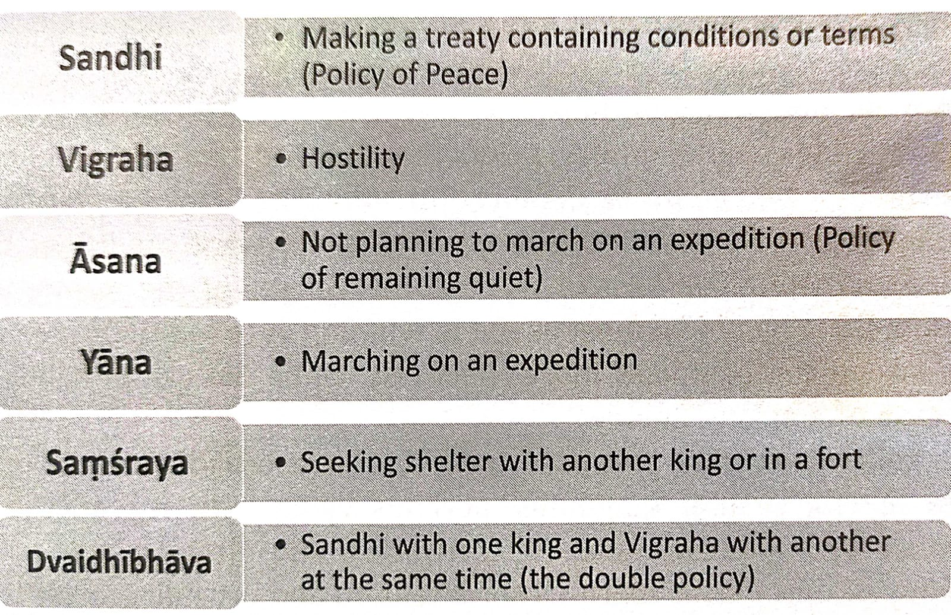
The Seven Limbs of the State
The Six methods of Foreign Policy
(According to Arthasastra of Kauṭilya)

Slide 98
The Seven Limbs of the State
They should be loyal. Friends add to the power of the state. They are also important from foreign trade view point.
These theory also known as “THE SAPTANGA THEORY: ELEMENTS OF STATE”.
In Manusmriti, Manu deals with seven Prakritis of the state like king, the ministers, the capital, the realm, the treasure, the army and ally.
But Kautilya in his Arthashastra put the same in a different order like the swami, the Amatyas, the Janapada, the Durgas, the Kosha, the Danda, the Mitra and the enemy.

Slide 99
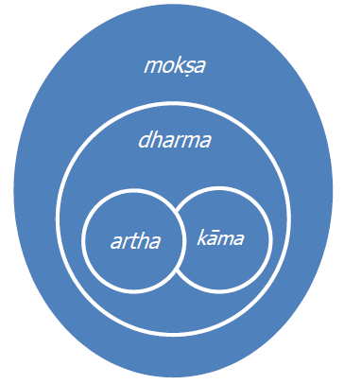
Society in Ancient India (CO1)
Society in ancient India had several distinguishing features. It was arranged in the form of four varnas.
The life of individual was divided into four stages or āshramas. There were rules regarding marriage, family etc.
The purpose of life was to attain four goals called purusārthas.
These four purusārthas are —
(a) dharma,
(b) artha,
(c) kāma and
(d) moksha.

Slide 100
Purusārtha
The concept of purusārthas is the fundamental principle of Indian social ethics. The word purusārtha means “attainments” or “life purposes”.
The aim of every person is to attain the four noble ends or purusārtha.
These four purusārthas are — dharma, artha, kāma and moksha.
Dharma :- Dharma or the principle of righteousness is considered to be the supreme of the purusārthas.
It is derived from the Sanskrit root dhr, which connotes to sustain, support or uphold. Dharma in ancient India was a code of conduct for members of the society.

Slide 101
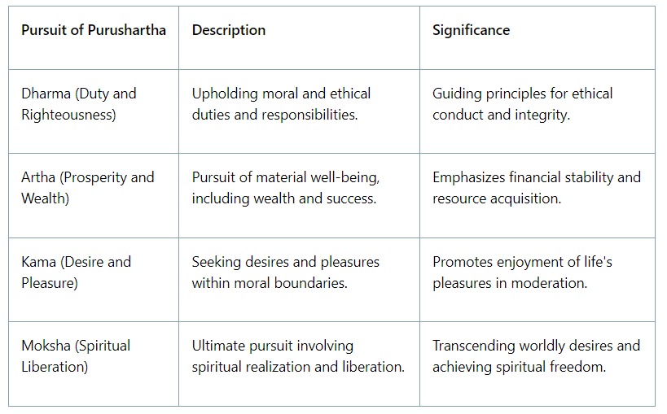
Purusārtha

Slide 102
Purusārtha-Dharma
The term dharma does not mean mere religion; it stands for duty, obligation and righteousness.
It is a whole way of life in which ethical values are considered supreme and everyone is expected to perform his or her duty according to his or her social position and station in life.
In Buddhism, the word dhamma is used, which is the Pāli equivalent of the Sanskrit word dharma.
The guidelines and rules regarding what is considered as appropriate behaviour for human beings are prescribed in the Dharma Śāstras.

Slide 103
Purusārtha-Dharma
These are sociological texts that tell us about our duties and obligations as individuals as well as members of society.
The concept of right and wrong is the core of the Mahābhārata which emphasizes, among others, the values of non-violence, truthfulness, absence of anger, charity, forgiveness and self realization.
It is only by performing one’s righteous duties or dharma that one can hope to attain the supreme path to the highest good.

Slide 104
Purusārtha
The various forms of dharma in the sense of duty in ancient India like-
Sāmānya Dharma--Some general rules which are universal in nature like truth, non-violence and non-stealing.
2. Rāj Dharma— Duties of the king.
3. Stree Dharma— Duties of woman.
4. Dāmpatya Dharma— Duties of husband and wife.
5. Varna Dharma— Duties of varnas.
6. Āshrama Dharma— Duties in the different stages of life.
Āpad Dharma— Duties during the crisis period.

Slide 105
Purusārtha
Artha :-
Artha is the second purusārtha.
The term artha refers to worldly prosperity or wealth.
It includes all the material means of life.
In the Bhagavad-Gītā, selfless action (niśkāma karma) is advocated.
It is an action which is required to be performed without consideration of personal consequences.
It is an altruistic action aimed at the well-being of others rather than for oneself. This doctrine is known as karma yoga.

Slide 106
Purusārtha
Kāma:-
Kāma means worldly pleasures or sensual pleasures.
It refers to some of the innate desires and urges in human beings.
Moksha
It is the ultimate purusārtha.
Moksha means salvation or liberation from the cycle of birth and death.
Ethics (nītīśāstra) is a branch of philosophy that deals with moral values.

Slide 107
Purusārtha
In every religious tradition, good moral conduct is considered essential for a happy and contented life.
Without following the path of righteousness no one can attain supreme goal (mokṣa) of life.
For this one has to perform good deeds and avoid wrong-doing.

Slide 108
Significance of Purusārtha
Purusārtha is a cornerstone of ancient Indian philosophy, emphasizing the holistic approach to life and the pursuit of a meaningful existence. Here are some key aspects of its significance:
Balanced Life: It promotes the idea that life should be lived in a balanced and harmonious manner, taking into account various aspects of human existence.
Guidance: Purusārtha serves as a guiding principle for individuals, helping them prioritize their goals and actions.
Ethical Framework: It provides a moral and ethical framework for decision-making and conduct.
Path to Fulfillment: Understanding and aligning with Purusārtha can lead to a sense of fulfillment and purpose in life.

Slide 109
Varnāshrama System (CO1)
The vast population of the major segment of the Indian society is structured into and reduced to just four groups by the much-discussed varṇa vyavasthā, which the Portuguese first described as ‘caste system’.
These are four functional divisions to be identified in any society —intellectuals / thinkers, warriors / defenders, traders and the service class. The difference from other societies is that in India this functional division was codified into a social organizing principle, something that for all its unifying purpose degenerated into a hereditary system.

Slide 110
Varnāshrama System (CO1)
Each varṇa is structured downwards in a hierarchy of expanding crisscross of parameters of ethnicity, subgroups, geographic area, village, gotra (relational sub-subgroup), language, profession, religion. This is a highly intricate social organization, which both separates an individual or a community from others, and at the same time makes all a part of each other.
This segment of India’s social life is knitted, among others, by the shared obligations that flow from two networks, the network of identity and the network of familial relationships.

Slide 111
Varnāshrama System (CO1)
In ancient India there was a common dharma for all members of society which must be followed by all equally. But at the same time there were different codes of conduct for different classes or varnas called varna-dharma. Similarly, it was desired to follow different dharma at the different stages or āshrama of life called āshrama-dharma.
First reference of varna is seen in the Rig Veda.
In ancient Iran the fourfold grouping into
a. Atharva(Priest)
b. Rathestha (Warrior)
c. Vastrya-fsuyant (head of the family)
d. Huiti (Manual worker)

Slide 112
Varnāshrama System
Types of Varnashrama system
Brahmins:-
Brahmins were at the top of varna hierarchy.
They were believed to possess great spiritual powers.
Thus they had a divine existence. In law, they claimed great privileges. Normally brahmins were exempt from execution, torture and corporal punishment.
The main functions prescribed for brahmins were learning, teaching and priesthood.

Slide 113
Varnāshrama System
Kshatriya:-
The second class was the ruling class described as kshatriya or rājanya. Kshatriyas represented heroism, courage and strength. They constituted the warrior class.
The duty of kshatriyas was protection which had both internal and external aspects.
External protection meant to protect the society from external invasion where as internal protection meant governance in peace and protection from anarchy.
Kshatriyas had the right to possess arms.

Slide 114
Varnāshrama System
Vaishyas:-
Vaishyas represented the trading and commercial class.
According to Manu the main task of the vaishya was to keep and maintain cattle. But it seems that later on vaishyas became economically a very important class of society.
The ideal vaishya possessed the expert knowledge of jewels, metals, cloth, threads, spices, perfumes etc. In this sense vaishyas were the ancient Indian businessmen.

Slide 115
Varnāshrama System
Shudras
Shudras were at the bottom of the social hierarchy. They pursued the task of serving the other three varnas.
They were deprived of various rights.
Later on the four varnas were divided into various subcategories called caste.

Slide 116
Āshrama or the Stages of Life (CO1)
The ashrama system denotes the Hindu scheme of life according to which different stages in the life of an individual are well ordered.
The average life span of an individual is considered to be 100 years and it is divided into four stages each stage having a time span of 25 years. These four āshramas are:
Brahmacharyāshrama or the Stage of Studentship :-
This is the first stage of life. It is meant for acquiring knowledge, developing discipline and moulding character.
This stage starts with the ceremony called upanayanama or investiture with the sacred thread.

Slide 117
Āshrama or the Stages of Life
Now the person became a brahmachārina, leading a celibate and austere life as a student at the home of his teacher.
Grihasthāshrama or the Stage of Householder :-
This stage starts at marriage when the student has completed his studentship and is ready to take up the duties and responsibilities of household life.
In this stage the individual gets married, earns money and begets children.
The individual pursues wealth (artha) and pleasure (kāma) within the limits of the moral law (dharma).

Slide 118
Āshrama or the Stages of Life
The second āśrama, gṛhastha, the long stage of married life devoted to raising a family, is acknowledged by all thinkers as the most important and also the most arduous of the four āśramas.
It involves all-round responsibilities, of parents towards children, of children towards each other and towards parents, of the mother and the father towards all, including the larger family.
This stage in life is at the same time the most full, rich and colourful innumerable festive rituals and ceremonies, in particular those called solah saṁskāras or ‘sixteen ceremonies’, accompany an individual all through his or her life birth, initiation into study, completion of education, engagement, marriage, birth of children, marriage of children,

Slide 119
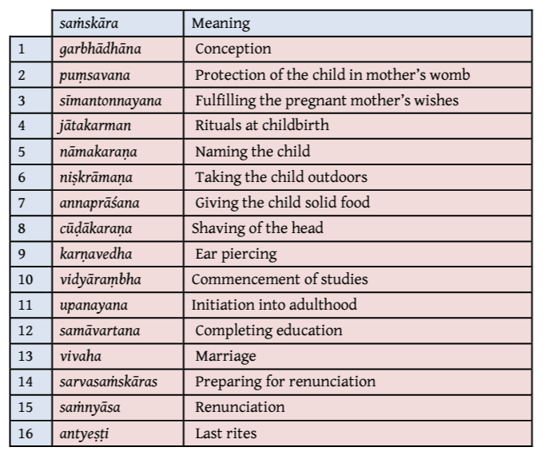
Āshrama or the Stages of Life
particularly of the daughter, death of the parents and memorial ceremony for them, the entire process ending in one’s death (see table below).
List of the solah saṁskāras or ‘sixteen ceremonies’

Slide 120
Āshrama or the Stages of Life
Vānaprasthāsharma or the Stage of Retirement from Active Life—
After discharging all the duties and obligations as a householder, the individual enters into the Vānaprastha stage.
It consists of the third quarter of person’s life.
In this phase, after retiring from active life, the individual dedicates himself to a life of spiritual contemplation.
He leaves his home and goes to the forest to become a hermit.

Slide 121
Āshrama or the Stages of Life
Sanyāsāshrama or the Stage of Renunciation or Wandering Mystic—
This is the last stage of life.
Now the individual leaves his hermitage an becomes a homeless wanderer (sanyāsin) with all his earthly ties broken.
The sanyāsin aspires and acts to attain liberation only.

Slide 122
Marriage (CO1)
Family is the keystone of the social arch: marriage is the instrument of family and the mother/wife is the custodian of marriage.
Family is sacrosanct and that involves an elaborate code of duties for each member of the family. Family is also the economic unit and as such it takes care of all members regardless of how much they earn and contribute individually to the ‘family income’.
It is a protection against adversity and a strong instrument of social security, something that costs Western nations huge amounts of public money to provide to its citizens. Because ‘family’ results from marriage, marriage is also sacrosanct.

Slide 123
Marriage (CO1)
Marriage or vivāha was a very important samskāra in ancient India.
The purposes of marriage in ancient India is as follow:-
Promotion of religion by performance of household sacrifices.
Progency or the happy after life of father and his ancestors and continuation of family line or kula.
The Rigvedic marriage hymn states, “I take your hand in mine for happy fortune that you may reach old age with me your husband.” (10.85.36) Marriage customs and rituals vary according to communities and other subgroups.

Slide 124
Marriage (CO1)
Manu and other law givers have mentioned about eight forms of marriage:
Brahma Vivāha: This is considered to be the purest form of marriage. In this form of marriage the father of the bride offers his daughter to a man of character and learning.
The daughter who is decked with ornaments and richly dressed is given as a gift to a man of good character and high learning.
Daiva Vivāha: In the daiva form of marriage the father offers her daughter as a dakshinā (sacrificial fee) to a young priest who officiates the yajna which is arranged by him.

Slide 125
Marriage
Ārsa Vivāha: -
In ārsa vivāha father of the bride gives his daughter to the bridegroom after receiving a cow and a bull or two pairs of these animals from the bridegroom.
Prajāpatya Vivāha:
In this type of marriage, the father offers the girl to the bridegroom. But neither does he offer any dowry nor does he demand bride-price.

Slide 126
Marriage
Asura Vivāha:
This is a form of marriage by purchase in which the bridegroom has to give money to the father or kinsman of the bride.
Gandharva Vivāha:
This was a marriage by consent of the boy and the girl. Mutual love and consent of the bride and bridegroom was the only condition required to bring about the union.

Slide 127
Marriage
Rākshasa Vivāha: This was marriage by capture in which the girl was forcibly abducted from her home, crying and weeping and her kinsmen have been stained and their houses broken.
Paishācha Vivāha: Paishācha form of marriage is one in which the man seduces by force a girl who is sleeping or intoxicated or mentally disordered.
Out of these eight forms of marriage the first four have been described as prashasta or approved or desirable marriage whereas the rest of the four forms have been considered to be aprashasta or disapproved or undesirable marriages.

Slide 128
Marriage
Anuloma marriage (hypergamy): In Anuloma marriage the groom belonged to a higher Varna and the bride to a lower varna.
Pratiloma marriage (hypogamy): In Pratiloma marriage the groom belonged to a lower varna and the bride to a higher varna. Both marriage were prevalent during the Vedic age. This practice continued till the mauryan age.
Monogamy : When marriage involves one husband and one wife alone.
Polygamy : When marriage involves more than one mate at one time.
Polyandry : When more than one man is married to a woman.
Polygyny : When more than one woman is married to a man.

Slide 129
Marriage
Levirate: Levirate is the custom in which a widow marries her husband’s brother. Generally husband’s younger brother marries the widow. This practice is prevalent among the Toda of Nilgiri Hills.
Sororate: Sororate is the custom in which a widower marries the younger sister of his deceased wife. It is generally found among the tribes of central India such as Gond or Baiga.
Endogamy : When marriage is within a specific Varna, class or tribal group.
Exogamy : When marriage occurs outside a certain group of relations.

Slide 130
Recap
Different theories of society formation in Ancient India
In this topic, we have learned the Seven limbs of the state, Society in
ancient India and Purusartha.
We also learned the Varnashrama system, Ashrama and Marriage in ancient India.

Slide 131
Daily Quiz
Marriage by consent of the boy and the girl is known as: -
A. Asura Vivaha
B. Gandharva Vivaha
C. Prajapatya Vivaha
D. Brahma Vivaha
According to Arthashastra of Kautila, what is Dandanīti?
A. The code of conduct of Amatya
B. The administration of force
C. The conduct of kings
D. The essence of Politics
The Stage of Renunciation, is known as______.
A. Brahmacharyāshrama
B. Grihasthāshrama
C. Vānaprasthāsharma
D. Sanyāsāshrama

Slide 132
Daily Quiz
The Stage of Householder, is known as______.
A. Brahmacharyāshrama
B. Grihasthāshrama
C. Vānaprasthāsharma
D. Sanyāsāshrama
The Stage of Studentship, is known as______.
A. Brahmacharyāshrama
B. Grihasthāshrama
C. Vānaprasthāsharma
D. Sanyāsāshrama
The Stage of Retirement from Active Life, is known as______.
A. Brahmacharyāshrama
B. Grihasthāshrama
C. Vānaprasthāsharma
D. Sanyāsāshrama

Slide 133
Daily Quiz
What is Dāmpatya Dharma?
A. Duties of woman
B. Duties in the different stages of life
C. Duties of husband and wife
D. Duties during the crisis period
What is Raj Dharma?
A. Duties of woman
B. Duties in the different stages of life
C. Duties of husband and wife
D. Duties of king
What is Apad Dharma?
A. Duties of woman
B. Duties in the different stages of life
C. Duties of husband and wife
D. Duties during the crisis period

Slide 134
Weekly Assignment
Explain different types of marriage in ancient India.
What is Purusartha? Explain its types in detail.

Slide 135
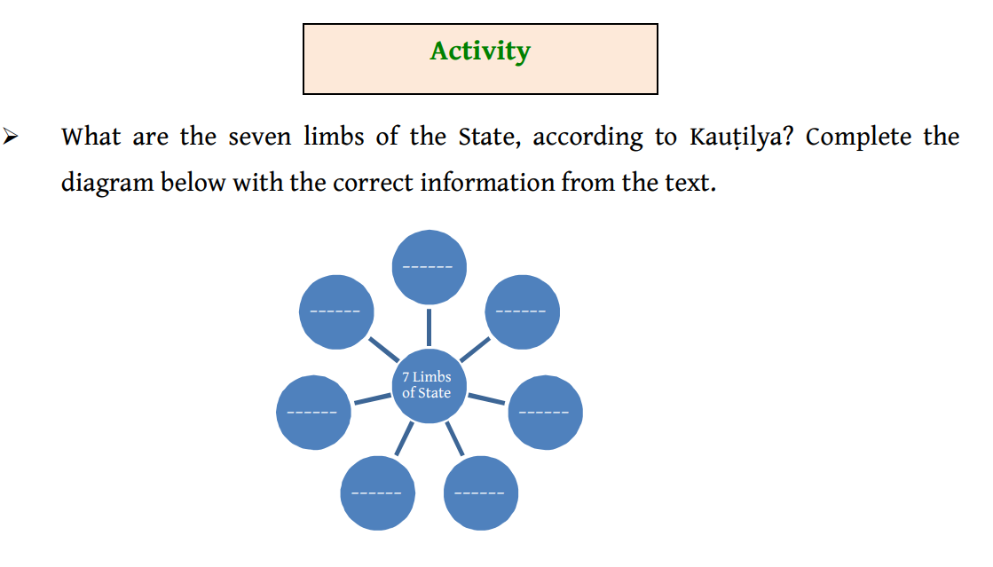
Weekly Assignment

Slide 136
Prerequisite
Basic knowledge of Indian Society
Participation of women in ancient times
Mauryan Era history
Gupta period history
Vedic History

Slide 137
Topic Objective
To study the different theories of the formation of society
To understand gender as a social category
To understand the condition & status of women in Ancient India
To study the four- class classification theory & slavery

Slide 138
Topic Mapping
S.No. | Topic | Course Outcome
1 | Understanding Gender as a social category | CO1
2 | The representation of Women in Historical Traditions & Challenges faced by Women | CO1
3 | Four-class Classification | CO1

Slide 139
Understanding Gender as a social category (CO1)
Gender studies was very much part of ancient India.
In Buddhist literature, greater importance is given to behaviour.
Manu lays down that brothers should separately give their shares to unmarried sisters, failing to do so brings doom upon them.
Gautam says that unmarried daughters not well settled in life shall inherit the property of their deceased father.
Girls were sometimes given some educational instructions, though Vedic learning.

Slide 140
The representation of Women in Historical
Traditions
Indian society, as way of life, generally attached high moral ground for women.
During Vedic period or early Vedic age (1500 BC–1000 BC), women were accorded high respect and dignity.
In fact, Rig Veda places women as central to creation of all lives in the cosmos. In education, women enjoyed equality with men.
Even they were allowed to spend life in ‘Gurukul'. Education is considered as an important qualification for women’s marriage. There were women poets like Apala, Viswavara, Ghosa and Lopamudra during this era which is also called Rig Vedic period.

Slide 141
Challenges faced by Women
Property inheritance is very limited.
In Later Vedic Period (1000 BC–500 BC) , Women were denied to read Vedic texts and Education opportunities were also denied.
In the Medieval Period, Sati Pratha, inhuman condition of widow.
Challenged faced by women during 18th century - Female Infanticide, Child Marriage, Denial of Education, Menace Dowry, Prevalence of Sati, Humiliation of Widows, Containment of Women in House, No Property Rights, Practice of Purdah System, Domestic Violence, Little Religious Freedom & No to Politics.

Slide 142
Four-class Classification
The four-class classification is found in Abū’l Fazl, by whom the learned are relegated to the third position.
The people of the world may be divided into four classes:
Warriors, who in the political body have the nature of fire. Their flames; directed by understanding, consume the straw and rubbish of rebellion and strife, but kindle also the lamp of rest in this world of disturbances.
Artificers and merchants, who hold the place of air. From their labours and travels, God’s gifts become universal, and the breeze of contentment nourishes the rose-tree of life.

Slide 143
Four-class Classification
The learned, such as the philosopher, the physician, the arithmetician, the geometrician, the astronomer, who resemble water. From their pen and their wisdom, a river rises in the drought of the world, and the garden of the creation receives from their irrigating powers, a peculiar freshness.
Husbandmen and labourers, who may be compared to earth. By their exertions, the staple of life is brought to perfection, and strength and happiness flow from their work.
It is therefore obligatory for a king to put each of these in its proper place, and by uniting personal ability with due respect for others, to cause the world to flourish. (From Abū’l Fazl, Ā’in-i-Akbarī, iv-v, Sources of Indian
Tradition, p. 513)

Slide 144
Recap
Different theories of society formation in Ancient India
In this topic, we have learned Understanding gender as a social category,
the representation of woman in historical tradition.
We also learned the Challenged faced by woman, Four class classification and slavery.

Slide 145
Daily Quiz
_____ says that unmarried daughters not well settled in life shall inherit the property of their deceased father.
A. Manu
B. Alteker
C. Gautam
D. Pulatsh
Rig Veda places women as central to creation of all lives in the cosmos. A. Rigveda
B. Samaveda
C. Vishnu Puran
D. Atharva Veda
During Vedic period or early Vedic age women were accorded high respect and dignity.
A. True
B. False

Slide 146
Daily Quiz
Which one of the following is not the part of four class classification theory.
A. Brahmin
B. Feudal
C. King
D. Shudra
Which Historian compared the Mauryan council of Ministers with the Privy council of Britain?
A. A. S. Altekar
B. Romali Thapar
C. Bipin Chandra
D. R. C. Majumdar
Women were not allowed to read the Vedic text during Vedic era.
A. True
B. False

Slide 147
Daily Quiz
Which philosopher explained human nature in terms of essential social virtues?
A. Hobbes
B. Rousseau
C. Locke
D. V.A. Smith
James Mill divided Indian History into ____periods.
A. Two
B. Three
C. Four
D. Five
In Later Vedic Period Women were denied to read Vedic texts.
A. True
B. False

Slide 148
Weekly Assignment
What were the challenged faced by woman in ancient time in India?
Explain the condition of slaves in ancient India.

Slide 149

Video Link
(Basic of Art and Culture)
https://www.youtube.com/watch?v=wjepzXnEqYo

Slide 150
Faculty Video Links, YouTube & NPTEL Video Links and Online Courses Details
YouTube/other Video Links
https://www.youtube.com/watch?v=wjepzXnEqYo
https://www.youtube.com/watch?v=mqSkJIRuBNU
https://www.youtube.com/watch?v=sfzON9BpYaM
https://www.youtube.com/watch?v=CVM7FWttwsE
https://www.youtube.com/watch?v=np0-CSC8L1k

Slide 151
MCQ
Dīgha Nikāya is the text of ______.
A. Jainism
B. Buddhist
C. Hindus
D. Muslim
What are types of marriage as stated by Manu?
A. Six
B. Seven
C. Eight
D. Nine
The theory of origin of state in ancient India stated that ‘Origin of state was based on divine creation’
A. Evolutionary Origin Theory
B. Force Theory
C. Theory of Mystical origin
D. Contract Theory

Slide 152
MCQ
James Mill divided Indian History into ____periods.
A. Two
B. Three
C. Four
D. Five
“The Early History of India” is written by______.
A. Charles Grant
B. Henry Thornton
C. James Mill
D. Vincent A. Smith

Slide 153
Daily Quiz
What is Dāmpatya Dharma?
A. Duties of woman
B. Duties in the different stages of life
C. Duties of husband and wife
D. Duties during the crisis period
What is ‘mahāmātras’ mentioned in the Kautila’s Arthashāstra?
A. Tirthas
B. Amātya
C. Adhyaksas
D. Yogakshema

Slide 154
Daily Quiz
According to Kautilya, what is svadharma?
A. Duty of senapati to do the welfare work and protect its people
from enemies
B. Duty of Council of minister to protect the life of king
C. Duty of King to protect the life, property and territory of his
people and kingdom
D. Duty of Amatya to suggest welfare work and establish a
training centre for army
"Where the land is kingless die cloud, lightning wreathed and loud voiced, gives no rain to the earth”, is described about _____.
A. Administration of any state
B. Mantrina
C. Political ideals in ancient India
D. Kingship

Slide 155
Glossary Questions
Pick the correct answer from given Glossary
Grihasthāshram Brahmacharyāshrama Vānaprasthāsharma Sanyāsāshrama
The Stage of Householder, is known as______.
The Stage of Studentship, is known as______.
The Stage of Retirement from Active Life, is known as______.
The Stage of Renunciation or Wandering Mystic is known as______.

Slide 156
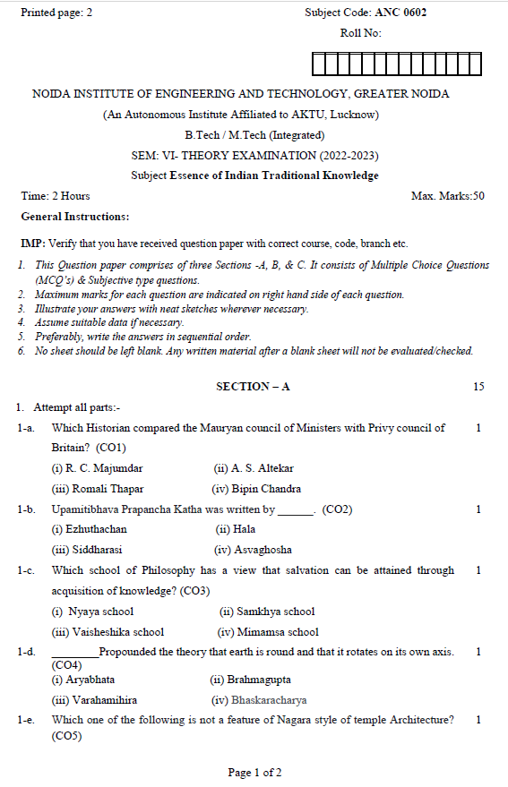
Old Question Papers

Slide 157
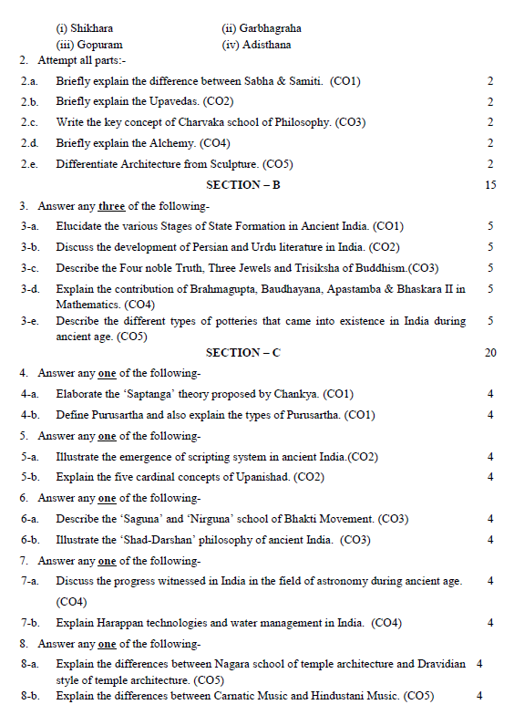
Old Question Papers

Slide 158
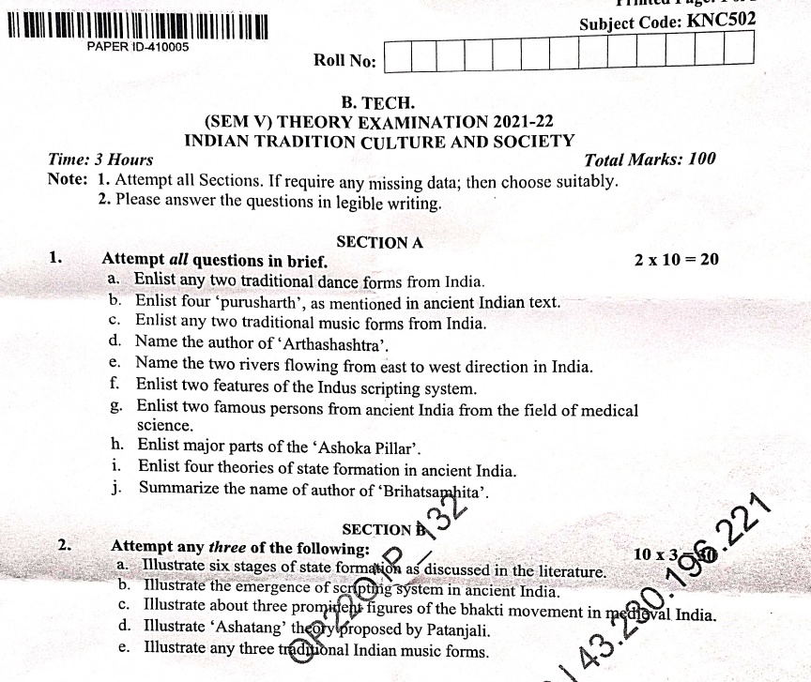
Old Question Papers

Slide 159

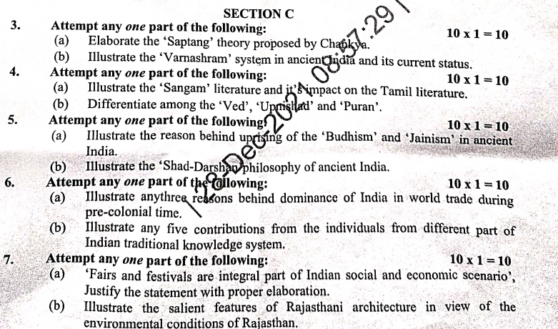
Old Question Papers

Slide 160
Expected Questions for University Exam
Describe the different theories of the origin of state in Ancient India.
Explain the Kautilya’s SAPTANGA theory of state.
What are the stages of life in ancient India? Explain each of them.
Explain the condition of slaves in ancient India.
Explain four class classification theory in ancient India.
Explain different types of marriage in ancient India.
What is Purusartha? Explain its types in detail.
Differentiate the following
(a) Sabha & Samiti (b) Mantrina & Mantri parishad

Slide 161
Recap of unit
The various forms of dharma in the sense of duty in ancient India like-
1. Sāmānya Dharma--Some general rules which are universal in nature like truth, non-violence and non-stealing.
2. Rāj Dharma— Duties of the king.
3. Stree Dharma— Duties of woman.
4. Dāmpatya Dharma— Duties of husband and wife.
5. Varna Dharma— Duties of varnas.
6. Āshrama Dharma— Duties in the different stages of life.
7. Āpad Dharma— Duties during the crisis period.

Slide 162
References
V. Sivaramakrishna (Ed.), Cultural Heritage of India-Course Material, Bharatiya Vidya Bhavan, Mumbai, 5th Edition, 2014
S. Baliyan, Indian Art and Culture, Oxford University Press, India
Romila Thapar, Readings In Early Indian History Oxford University Press , India
P R Sharma ( English translation), Shodashang Hridayam
Basham, A.L., The Wonder that was India (34th impression), New Delhi, Rupa & co
Sharma, R.S., Aspects of Political Ideas and Institutions in Ancient India(fourth edition), Delhi, Motilal Banarsidass.
Thank You

